Slide 1
Module 05: EDA – Two Variables

Slide 2
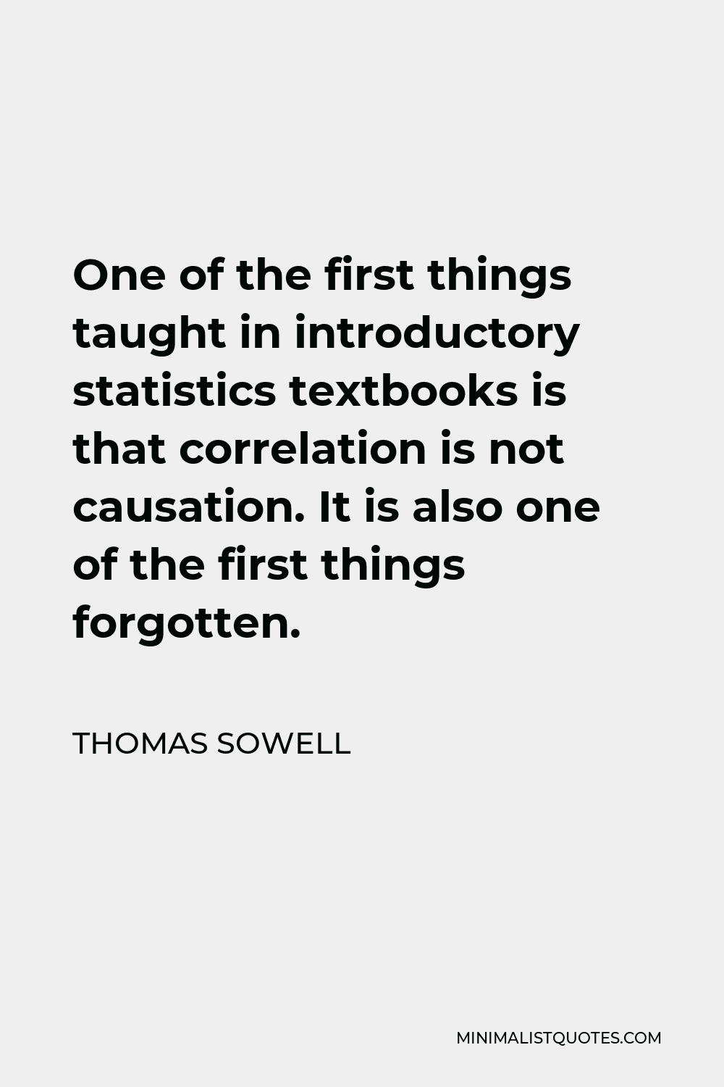
Notes:
Thomas Sowell is an American economist, social philosopher, and political commentator. He is a senior fellow at the Hoover Institution. With widely published commentary and books—and as a guest on TV and radio—he became a well-known voice in the American conservative movement as a prominent black conservative. -Wikipedia

Slide 3
Overview
In EDA for one variable, we basically look at every single variable to understand what they are about.
When doing data summary for two or more variables, it is a) more speculative (or guessing) and b) selective as it is very time-consuming to look at every permutation of variables.
In this course, there are 3 major situations in this course (with two variables).
1) Two numerical variables
2) Two Categorical Variables
3) One Numerical Variable and One Categorical Variable

Slide 4
Use or Role of Variables
With one variable, no roles need to be defined.
But the roles between two variables need to be established clearly.
1) Response variable, dependent variable or simply Y-variable.
2) Explanatory variable, independent variable or simply X-variable.
Generally speaking, we want to see how the response variable can be explained by the explanatory variable.
Or we want to see how the dependent variable will be depend upon the independent variable.
MLO: Identify the role between two variables.
Notes:
Example 1
Objective: To find out how GPA is dependent on the amount of gaming time among students.
Dependent Var: GPA
Independent Var: Amount of gaming time
Example 2
Objective: To find out how different genders of students have different amount of gaming time.
Dependent Var: Amount of gaming time
Independent Var: Gender

Slide 5
Two Numerical Variables - Graphs
We only have one graph: scatter diagram or scatterplot.
It is used to display or summarize the relationship between two numerical variables.
There are four key areas of the subjective description.
1) Direction of the relation – positive vs. Negative
2) Strength of the relation – strong vs. Weak
3) Outliers – Yes vs. No
4) Form of the relation – linear vs. Non-linear
MLO: Provide a description of the scatter diagram.

Slide 6
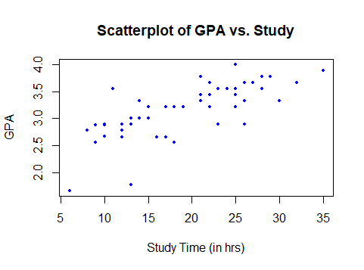
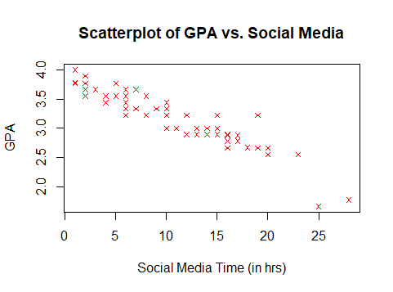
Scatterplots - Examples
We only have one graph: scatter diagram or scatterplot.
Provide a description of the following two scatterplots.
Notes:
Left hand one:
Direction: it shows positive relation
Strength: hard to tell, but it seems to have a strong relation
Outliers: potentially two obvious outliers, both near the bottom left corner
Form: for the most part, it has a linear relation
Right hand one:
Direction: it has negative relation
Strength: it seems to have a strong relation
Outliers: potentially two outliers, both on the bottom right corner (but they are not considered “influential points”)
Form: it has a linear relation

Slide 7
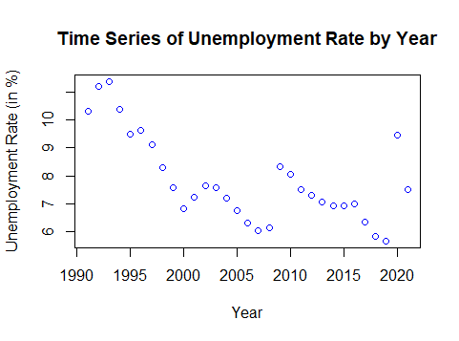
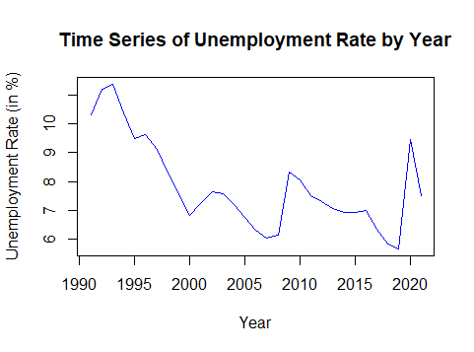
Time Series Plots – Honourable Mention
If you consider “time” as a numerical variable (where most people do), then time series plots fall under this classification.
Caution: The only problem with time is that it is not independent!
The left one is a “scatterplot” (with dots) and the right one is time series plot.

Slide 8
Two Numerical Variables - Statistics
There are two common statistics used to summarize two (or more) numerical variables: 1) Covariance (or Cov) and 2) Correlation Coefficient (or simply r).
Covariance is simpler to understand (as it comes from the idea of variance), but its value depends on the units of measurements.
Correlation Coefficient seems arbitrary (as its values go from -1 to +1), but it is independent of units used.
Study Time vs. GPA | Cov | r
Study Time (in hours) | 2.60 | 0.7338
Study Time (in minutes) | 156.06 | 0.7338

Slide 9
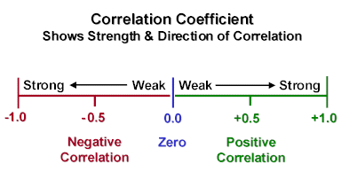
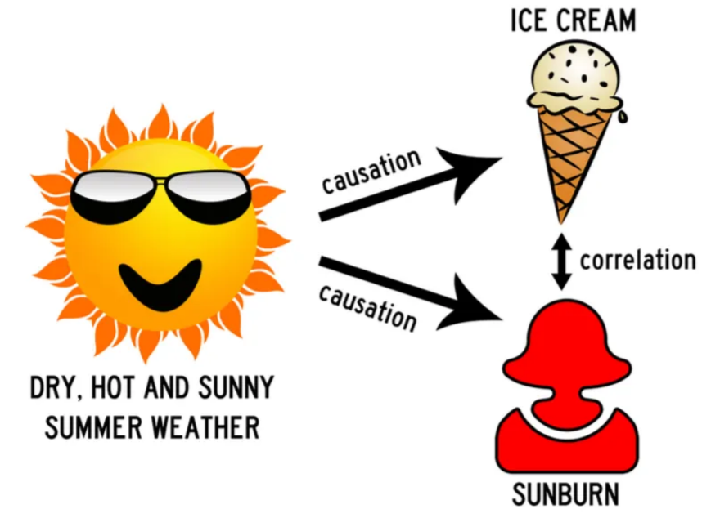
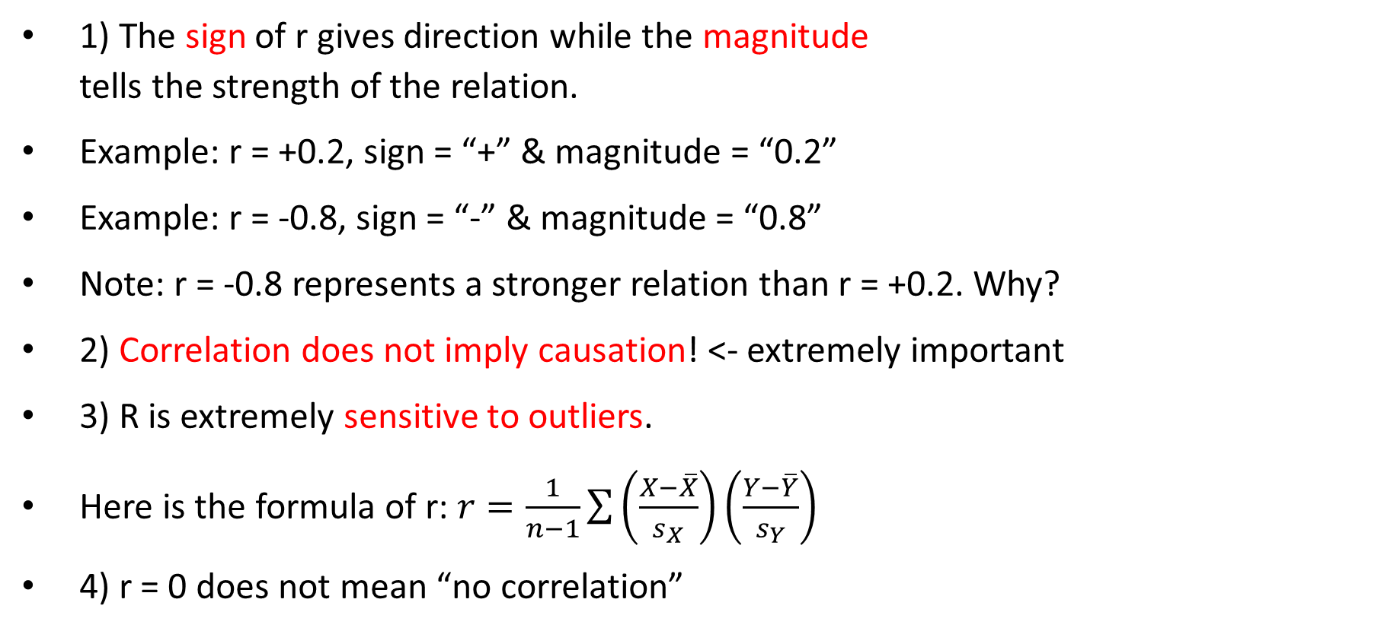
Basic Properties of r
1) The sign of r gives direction while the magnitude tells the strength of the relation.
Example: r = +0.2, sign = “+” & magnitude = “0.2”
Example: r = -0.8, sign = “-” & magnitude = “0.8”
Note: r = -0.8 represents a stronger relation than r = +0.2. Why?
2) Correlation does not imply causation! <- extremely important
3) R is extremely sensitive to outliers.
Here is the formula of r: $r=\frac{1}{n−1}\sum{\left(\frac{X−\overline{X}}{s_{X}}\right)\left(\frac{Y−\overline{Y}}{s_{Y}}\right)}$
4) r = 0 does not mean “no correlation”

Slide 10
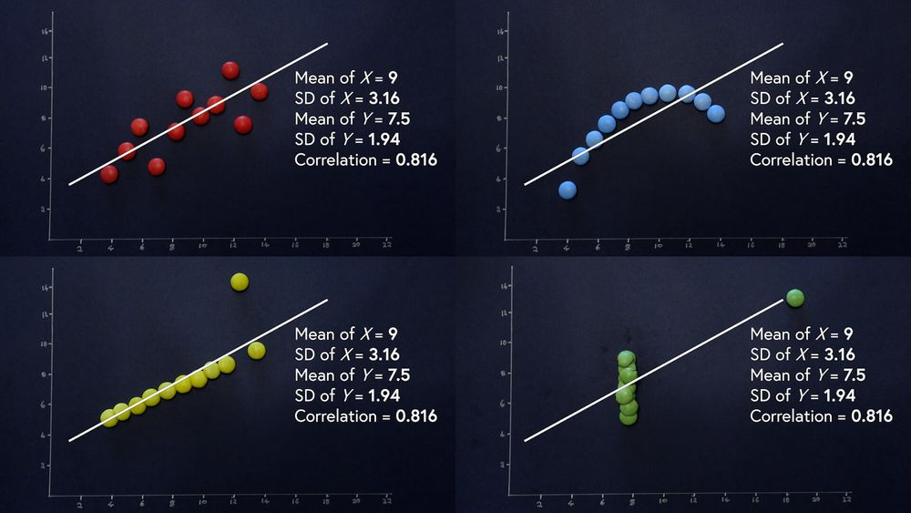
Anscombe’s Quartet
Francis Anscombe created four data sets essentially by hands (and probably with a simple calculator) in 1973.
These four data sets have - same mean of X & Y, - same SD of X & Y, - same r (with certain d.p.).
Takeaway: Never looks at statistics without also look at a graph!
Notes:
More information about Anscombe’s Quartet
https://www.geckoboard.com/blog/anscombes-quartet-why-summary-metrics-lie/

Slide 11

Datasaurus Dozen
In 2016, Alberto Cairo created 13 data sets with the help of computers.
Again, all 13 data sets give the same statistics (mean, SD of both x and y, plus r) up to 2 decimal places.
Same takeaway: never looks at statistics only without also look at the graph!
Notes:
More information about Datasaurus Dozen:
https://jumpingrivers.github.io/datasauRus/

Slide 12


Summary
Back to this course, the main takeaway is: It is tempting to just look at the correlation coefficient (a statistic) and make conclusion. Please make sure you look at the graphs (scatterplot) to get a complete picture!
 | Correlation Coefficient | Scatterplot
Direction
2) Strength
3) Outliers
4) Form

Slide 13
Independence Relationship
In general English, we have words like associations, relations, links, or connections.
In STAT (and some people in DS), there are definitely reserved words under certain situations.
We saw it in the last class that the relationship between two numerical variables is usually called correlation.
Here, the relationship between two categorical variables is called independence.
We want to see if the two variables are either 1) independent to each other or 2) not independent to each other.

Slide 14
Two Categorical Variables - Tables
There are many names – like two-way tables (my preference), cross tabulations, and contingency tables – but they all shows frequencies in a table.
Example: Here is a two-way table of status (INT vs. DOM) and acceptance (Yes vs. No) of all applicants (or apps). [INT = international; DOM = domestic]
Overall frequency (or n) = 2000
Row frequency = 952, 1048
Column frequency = 800, 1200
Observed frequency = 400, 552, 400, 648
Row variable = acceptance; number of rows = r = 2 (Yes, No)
Column variable = status; number of columns = c = 2 (INT, DOM)
 |  | Status
 |  | INT | DOM
Acceptance | Yes | 400 | 552 | 952
 | No | 400 | 648 | 1048
 |  | 800 | 1200 | 2000

Slide 15
Percentages from Two-Way Tables
Example: Here is a two-way table of status (INT vs. DOM) and acceptance (Yes vs. No) of all applicants (or apps). [INT = international; DOM = domestic]
Q1a: Find the % of DOM apps who got accepted.
Q1b: Find the % of apps who are DOM and got accepted.
Q1c: Find the % of “accepted apps” who are DOM.
Q2a: What does 552/2000 represent?
Q2b: What does 552/1200 represent?
Q2c: What does 552/952 represent?
 |  | Status
 |  | INT | DOM
Acceptance | Yes | 400 | 552 | 952
 | No | 400 | 648 | 1048
 |  | 800 | 1200 | 2000
Notes:
Q1a: 552/1200
Q1b: 552/2000
Q1c: 552/952
Q2a: percentage of all applicants who are accepted to the program and are domestic applicant
Q2b: percentage of domestic applicants who are accepted to the program
Q2c: percentage of accepted applicants who are domestic students

Slide 16
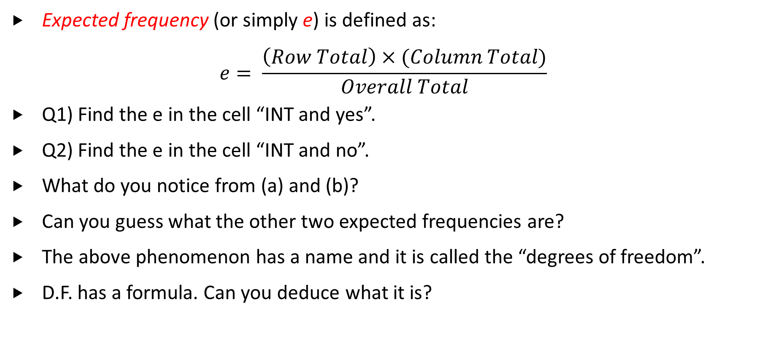
Expected Frequencies - Calculations
Expected frequency (or simply e) is defined as:
$$e= \frac{\left(Row Total\right)×(Column Total)}{Overall Total}$$
Q1) Find the e in the cell “INT and yes”.
Q2) Find the e in the cell “INT and no”.
What do you notice from (a) and (b)?
Can you guess what the other two expected frequencies are?
The above phenomenon has a name and it is called the “degrees of freedom”.
D.F. has a formula. Can you deduce what it is?
 |  | Status
 |  | INT | DOM
Acceptance | Yes | 400 | 552 | 952
 | No | 400 | 648 | 1048
 |  | 800 | 1200 | 2000
Notes:
Q1: e = 800*952/2000 = 380.8
Q2: e = 800*1048/2000 = 419.2
The sum of the two expected frequencies is the same as 800 (the column total)

Slide 17
Expected Frequencies - Interpretations
You can refer to the notes for more detail.
It refers to the frequency of a cell that we expect to see, but what does it base on?
It is based on an assumption that the two variables are independent to each other:
Heuristically, 1) if the two variables are independent to each other,
2) then knowing one thing does not give us more info about the other,
3) hence the same percentage applies to all strata (or different subgroups).
Note: Although it is a well-known assumption, it is essential that you include the assumption when interpreting its value.
 |  | Status
 |  | INT | DOM
Acceptance | Yes | 400 | 552 | 952
 | No | 400 | 648 | 1048
 |  | 800 | 1200 | 2000

Slide 18
Expected Frequencies - Precautions
Just like what we have learned so far, everything has a limit or deficiency.
The limit/deficiency is that expected frequencies cannot be too small or specifically cannot be smaller than 5.
Three typical situations that might lead to this.
1) when the sample size is too small, or
2) when the variables have too many classes, or
3) when the variables that have a very lopsided response. E.g. Do people own a smartphone? Do Langara student take transit to school?
In (3), the “no” group is too small and the issue is similar to (1).
Workaround: Avoid (3), reduce number of classes in (2), and/or increase n in (1).

Slide 19
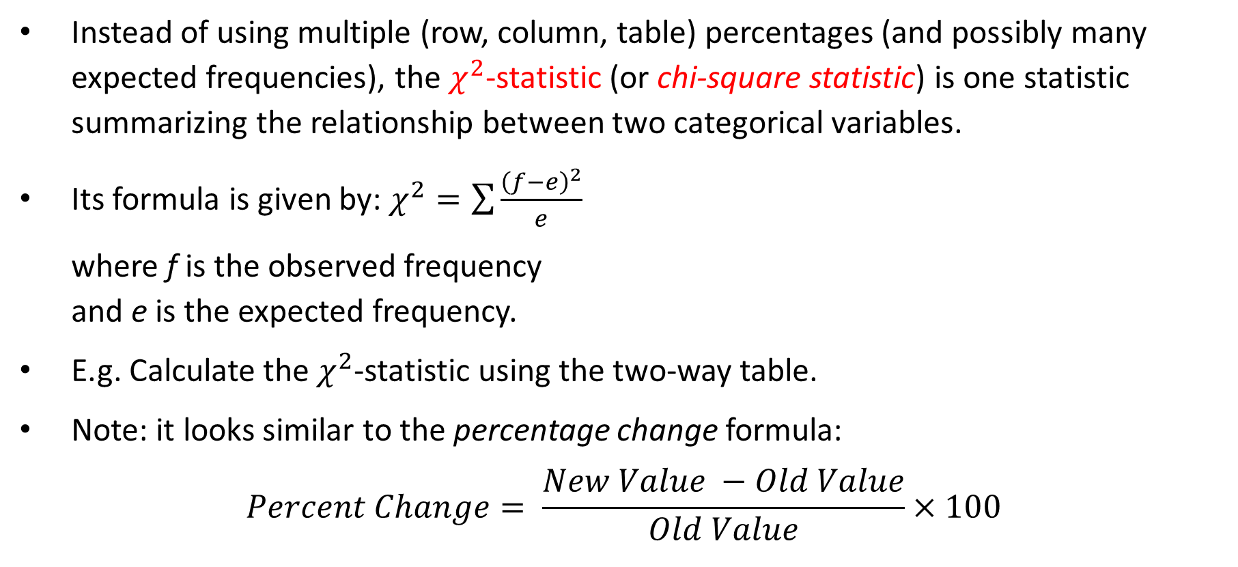
One “Overall” Statistic
Instead of using multiple (row, column, table) percentages (and possibly many expected frequencies), the $χ^{2}$-statistic (or chi-square statistic) is one statistic summarizing the relationship between two categorical variables.
Its formula is given by: $χ^{2}=\sum{\frac{{\left(f−e\right)}^{2}}{e}}$
where f is the observed frequency and e is the expected frequency.
E.g. Calculate the $χ^{2}$-statistic using the two-way table.
Note: it looks similar to the percentage change formula:
$$Percent Change= \frac{New Value −Old Value}{Old Value}×100$$
 |  | Status
 |  | INT | DOM
Acceptance | Yes | 400 (380.8) | 552 (571.2) | 952
 | No | 400 (419.2) | 648 (628.8) | 1048
 |  | 800 | 1200 | 2000
Notes:
Answer
Chi-square = 3.08 (using Excel)

Slide 20
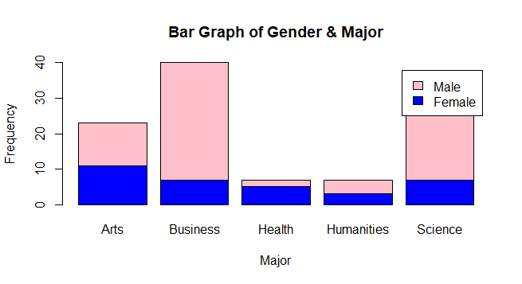
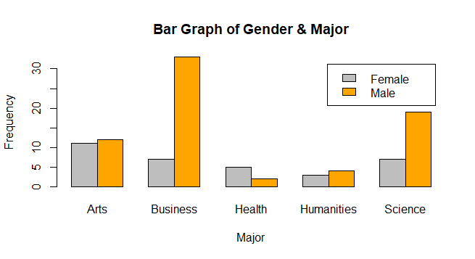
Bar Graphs for 2 Categorical Variables
2 graphs: stacked bar graphs (left) or side-by-side bar graphs (right).
Which one to use is mostly a personal preference?
I prefer the latter (right) one as I find it easier to spot “smaller” differences.
One shortcomings: hard to compare groups due to different sample size.

Slide 21
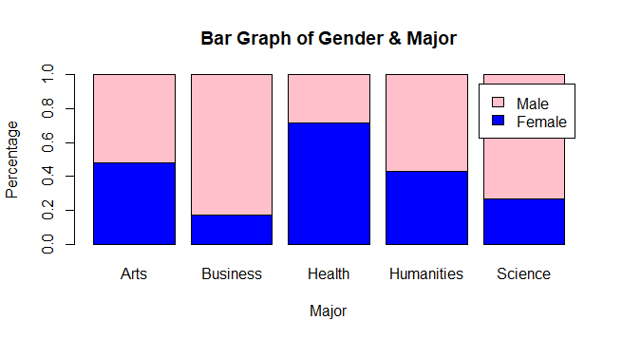
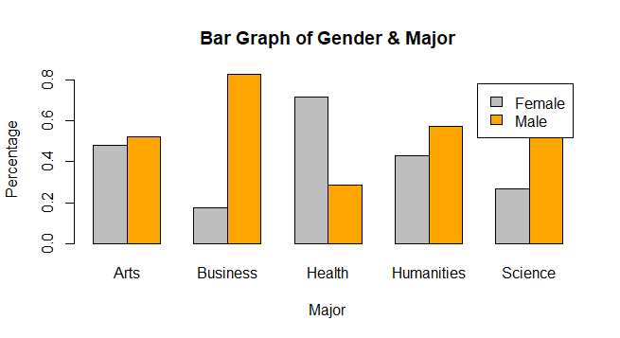
Bar Graphs - Modifications
The main focus is to neutralize the differences in sample size with each group.
→ make the plot with the sum of (column) percentages within each group to be 1
With this modification, both graphs are very good. In fact, the stacked version might even be more superior.

Slide 22
Bar Graphs - Descriptions
We mainly focus on how one stratum compares to the others.
The grey bar in Health is the only one taller than the orange bar.
→ The 5 groups of bars do not look alike.
Loosely speaking, the two categorical variables are not independent to each other.

Slide 23
Simpson’s Paradox
Program A |  | Status
 |  | INT | DOM
Acceptance | Yes | 160 | 420 | 580
 | No | 240 | 580 | 820
 |  | 400 | 1000 | 1400
Program A: % of INT got accepted: 160/400 = 40% % of DOM got accepted: 420/1000 = 42%
Program B: % of INT got accepted: 240/400 = 60% % of DOM got accepted: 132/200 = 66%
Both programs: % of INT got accepted: 400/800 = 50% % of DOM got accepted: 552/1200 = 46%
The culprit: the lurking variable “program” that might not be visible when looking at the bottom table
Program B |  | Status
 |  | INT | DOM
Acceptance | Yes | 240 | 132 | 372
 | No | 160 | 68 | 228
 |  | 400 | 200 | 600
Both Programs |  | Status
 |  | INT | DOM
Acceptance | Yes | 400 | 552 | 952
 | No | 400 | 648 | 1048
 |  | 800 | 1200 | 2000

Slide 24
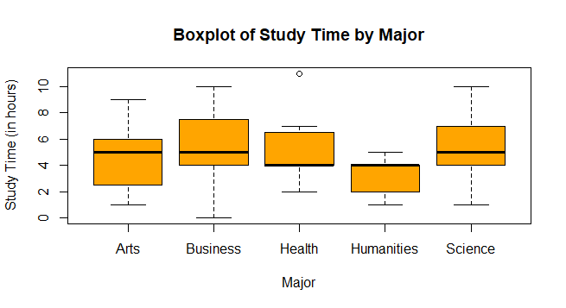
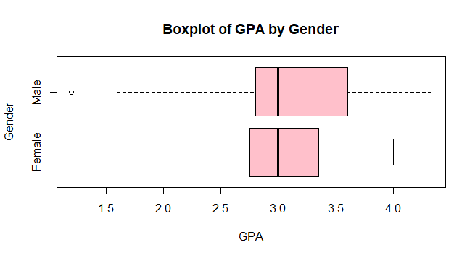
Num. Dep. Var. vs. Cat. Indep. Var.
Graphs: side-by-side boxplot
Statistics: t-statistic (DANA 4800) and F-statistic (more in DANA 4810)
Tools: Two-Sample t-Test (this course) or ANOVA=Analysis of Variance (DANA 4810)
Purpose: To see which categorical group is different from others
Provide a description of the following two graphs.

Slide 25

Any Questions?

